Slide 1
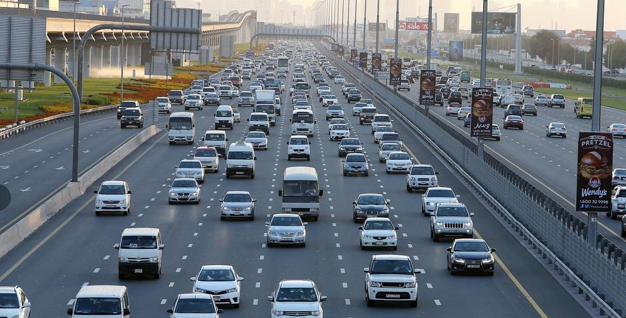
VEHICLE USER AUTHENTICATION USING OPENCV
Under the supervision of :
Prof Nidhi Singh
0103CS171006 Abhishek Jain
0103CS171046 Bhola Chilhate
0103CS171072 Krishna Yadav
0103CS171091 Ojasva Saxena

Slide 2

Agenda
Background Info
Problem Statement
Major objective and scope of project
Hardware/Software requirement
Proposed method
Project limitations and future scope
References

Slide 3
Literature Survey
In our country the number of underage children driving a vehicle is constantly increasing.
Adding on to it is are the people who are unfit to renew their driving license due to exceeding age of physical unfulfillment.
Charts shows total number of these people is still very less as compared to the valid license holders but when it comes to accidents, they are involved in almost 45%.
Thus people not having a valid license are a major factor contributing to road accidents.

Slide 4
Statistics

Slide 5

Problem Statement
The problem domain for this project is related to Road safety and Security.
A system should be developed to control the unauthorized access of vehicles and specially stop underage to drive a vehicle.
The people with valid driving license when identified should only given access to a vehicle to drive.

Slide 6
Major Objectives
Gathering all the information and the tools necessary for building this project.
Designing a meaningful and simplistic website for efficient usage of the system.
To design accurate user verification system using OpenCV tools.
Writing an optimized and robust code for the website design and the internal program.
To develop our website and its processes as fast, efficient and robust as possible.
Integrating the website and the internal program.
Performing thorough testing of the project.

Slide 7
Software Requirement
Languages
Python Libraries
Development Software
Other Req.
JavaScript
CSS
HTML
Python3
Numpy
OpenCV
Pickles
Apache Server
Anaconda
Notepad++
JS enabled web browser
OS(windows, Linux)
Coding Languages

Slide 8

Hardware Requirement
1
A working PC or Laptop with RAM min 1GB
2
A working webcam
3
Processor : Any (Intel, AMD, etc.)
4
GPU : Any (Nvidia, Intel, AMD)
5
Working Internet Connection

Slide 9
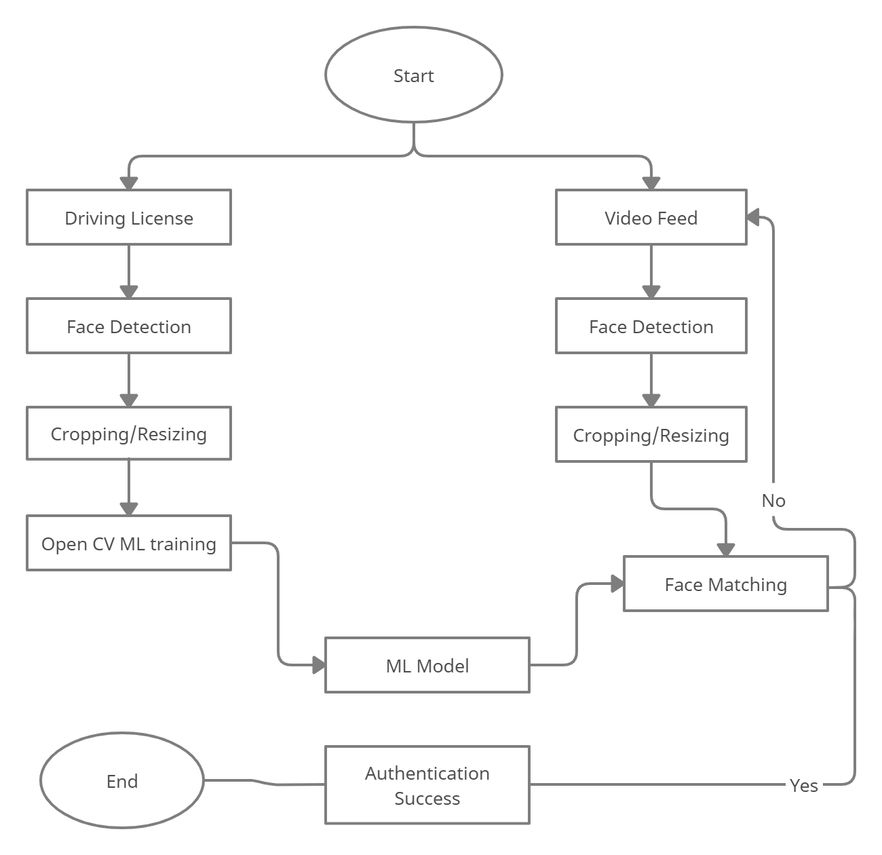
Proposed Method
Figure shows the Data Flow Diagram in which mainly two inputs, license image and video feed are taken from user and further processing on the images such as face detection, cropping and resizing of images are performed in real-time. Then the processed images are taken for Model training and face matching, and the process repeats for a certain limit, if face does not match. Otherwise, if match is found, access is granted to the user and the process ends. If match is not found after enough iterations, user is denied to access the vehicle.
1

Slide 10
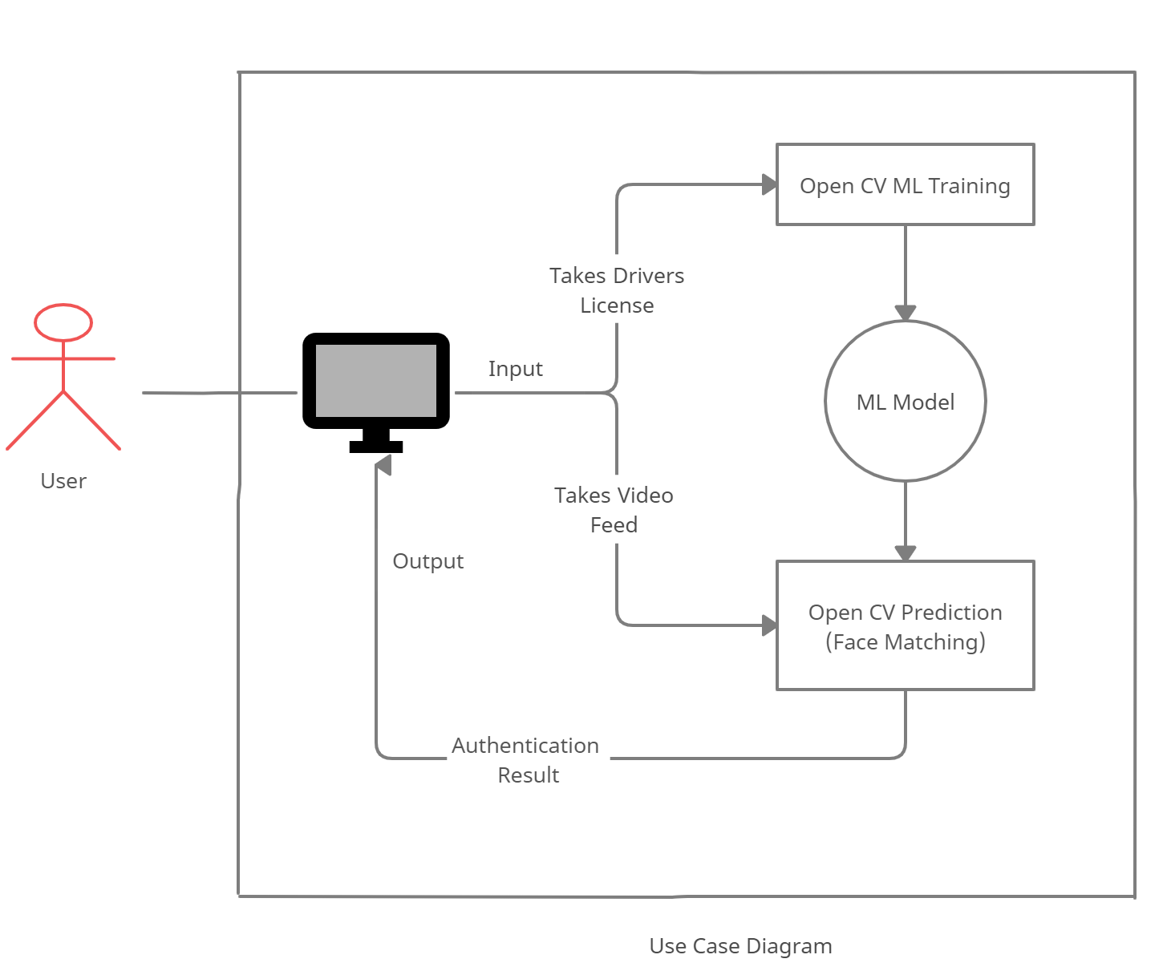
2
Figure shows the use-case diagram of the project, in which the user is asked his driving license first which is processed to train a model by using OpenCV library. Then the user is asked to provide his real-time video feed, which is processed by the machine and is further matched against the trained ML model. Using the results, the program decides whether to authenticate the user or not and displays out the result on the website for the user to see.

Slide 11
Project Limitations
This project only provide solution through website and it does not provide any application for the user. So, it is limited to websites only for now.
Face detection can be fooled by showing a photograph or similar faces.
The dataset used in developing the model is relatively small which might affect the accuracy of the prediction of our project.
Due to hardware limitations of the developing environment, the ML model is less reliable and less accurate.
In practice, ML model are never said to be always accurate in predicting as compared to actual human being’s prediction.

Slide 12
Future Scope
Following key points can add up to the future scope of the project:
We might embed our solution to Arduino or Raspberry Pi, so that we can test our system on actual vehicles or a simulated environment.
We might also validate driver’s license using online government servers for better security.
We might also add a functionality to allow only certain person to use vehicle, even if they have valid license, so that we can reduce Vehicle Theft.
We can improve our ML model’s accuracy by increasing development environment capabilities.

Slide 13

References
https://docs.opencv.org/
https://github.com/maddevsio/go-idmatch
https://github.com/CatalystCode/faceanalysis
https://github.com/domjhill/Python-FaceTemplateMatching
https://www.youtube.com/PmZ29Vta7Vc
https://www.google.com/

Slide 14
End of Presentation
Thank You

